Slide 1
Professional Development Program Data Collection System (PDPDCS)
Using Multifactor authentication

Slide 2
What is Multifactor Authentication (MFA)?
MFA is a security process that requires a user to verify their identity in multiple ways to gain system access
These multiple factors may include:
  Something only the individual user knows
  (e.g., a password)
  Something only the individual user possesses
  (e.g., a smartphone app or security token)

Slide 3
Why use MFA for the PDPDCS?
Use of MFA for the PDPDCS greatly reduces the chance of unauthorized access to your account thereby:
  Protecting your personally identifiable information (PII), including your social security number, home address, and contact information
  Significantly reducing the risk of a system-wide data breach

Slide 4
How to enroll in MFA for PDPDCS

Slide 5
What you need to Enroll
To enroll in multi-factor authentication for PDPDCS you will need the following:
Your PDPDCS username and password
Device to log into the PDPDCS (a computer, tablet, or other internet-connected device)
A smartphone with iOS or Android (in addition to the device to log into the PDPDCS)
  If you do not have a smartphone contact the Help Desk by phone (1-888-884-7110) or email (paybackobligations@ed.gov)

Slide 6
Overview of Steps to Enroll
Download and install the Google Authenticator application on your smartphone
Log into the PDPDCS
Pair the Google Authenticator app on your smartphone with the PDPDCS system
Moving forward, you will be prompted to enter a security code from your Google Authenticator app when you sign into the PDPDCS

Slide 7


Enrolling in MFA for the PDPDCS
Download and install Google Authenticator on your smartphone
  Google Authenticator is free and easy to set up
  The app is available through the Apple App Store or Google Play Store by searching for “Google Authenticator”
  If you are not sure where to locate the Apple App Store or Google Play Store on your smartphone, look for one of the icons below on your smartphone home screen or within your smartphone’s applications or “apps” section
https://www.apple.com/ios/app-store/
https://play.google.com

Slide 8

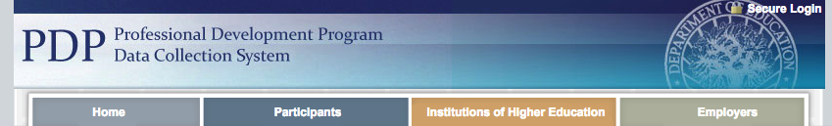
Enrolling in MFA for the PDPDCS
Navigate to the PDPDCS site
  On the device you’d like to sign into the PDPDCS on, navigate to https://pdp.ed.gov/OIE
  On the home page of the site,
  click Secure Login in the upper
  right corner

Slide 9
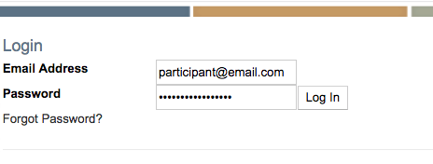
Enrolling in MFA for the PDPDCS
Log into the PDPDCS
  Login to the PDPDCS using your regular username and password

Slide 10
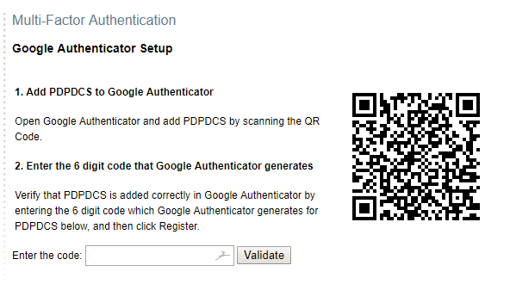
Enrolling in MFA for the PDPDCS
4. Open the enrollment page
When you login, you will be directed to the enrollment page
The enrollment page will
include a QR code and a
place to enter the code
generated by your Google
Authenticator app

Slide 11
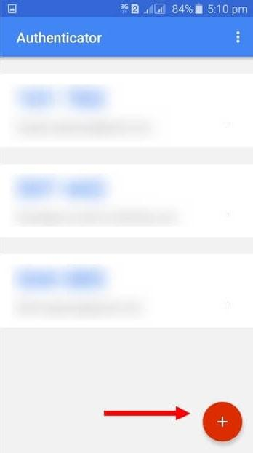
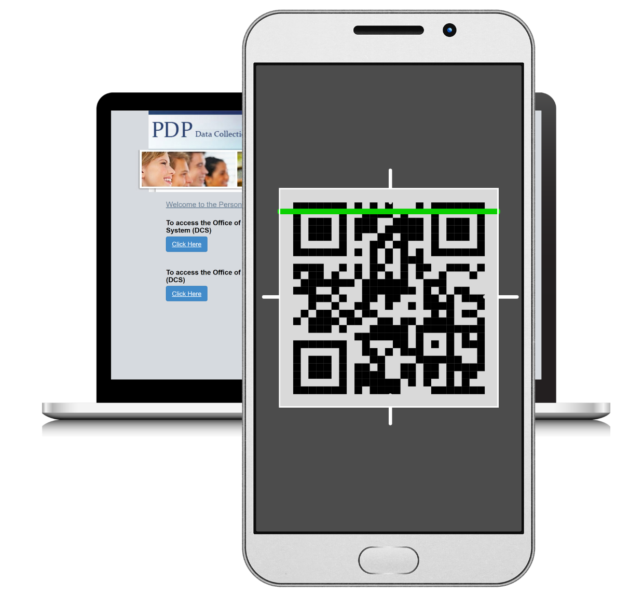
Enrolling in MFA for the PDPDCS
5. Pair the app and PDPDCS
Open the Google Authenticator app on your smartphone
Click the + button on the app to add the PDPDCS website
Scan the QR Code from the PDPDCS website enroll page on the enroll page with your cellphone

Slide 12

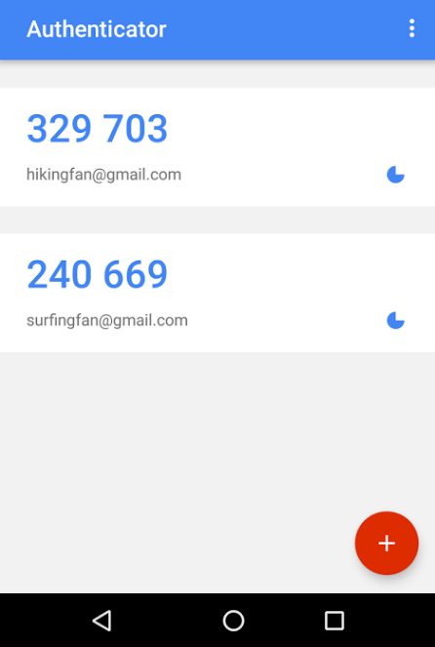
Enrolling in MFA for the PDPDCS
6. Enter code in the app
Enter the code generated by the Google Authenticator app into the PDPDCS enroll page and click “Validate”
Remember to enter the code quickly as each code is only valid for 30 seconds. As soon as another code is generated, the preceding one becomes invalid
6 digit code
Enter code here

Slide 13
Enrolling in MFA for the PDPDCS
SUCCESS!
If all steps were completed correctly, you should now have access to the PDPDCS!
If you are not able to enroll successfully, contact the PDPDCS Help Desk:
Support available from 8 am to 8 pm EST
Monday through Friday
1-888-884-7110
paybackobligations@ed.gov

Slide 14
Signing into the PDPDCS in the Future
Each time you sign into the PDPDCS from any device you will need to complete these 3 steps:
Enter your username and password in the PDPDCS
Open the Google Authenticator app on your smartphone and take note of the 6 digit security code generated by the app*
Enter the 6 digit security code into the PDPDCS when prompted by the system (prompt will occur after you enter your username and password)
*Remember: Each code is only valid for thirty seconds

Slide 15
Questions & Support: PDPDPCS Help Desk
Help Desk staff are available by phone or email to answer questions you may have regarding the PDPDCS
  To contact the Help Desk by phone:
    Toll Free Hotline: 1-888-884-7110
    Monday through Friday from 8 am to 8 pm, ET
    If someone is not available leave a message and staff will return your call within 1 business day
  To contact the Help Desk by email:
    paybackobligations@ed.gov
    Staff will respond within 1 business day

Slide 16
Questions & Support: PDPDPCS Help Desk
(continued)
If additional help is needed, a designated Help Desk specialist can talk with you one-on-one to walk you through each step of MFA set up
If interested, please contact the Help Desk by phone (1-888-884-7110) or email (paybackobligations@ed.gov) to set up an appointment

Slide 17
Frequently Asked Questions
Am I required to sign up for MFA for the PDPDCS?
  Yes, all users will need to set up MFA for the PDPDCS in order to access the system securely
What do I do if I don’t have a smartphone?
  Contact the Help Desk by phone (1-888-884-7110) or email (paybackobligations@ed.gov) and a Help Desk Specialist will assist you

Slide 18
Frequently Asked Questions (continued)
What do I do if I’ve downloaded the app and set up MFA, but don’t have my phone with me when I want to sign into the PDPDCS?
  Once you have set up MFA for the PDPDCS you must have access to the Google Authenticator app on your smartphone in order to login to the PDPDCS
What if I forget my password to sign into the PDPDCS?
  Go to https://pdp.ed.gov/OIE, click Secure Login in the upper right corner, enter your email address in the box and then click Forgot Password? directly underneath. A password reset link will be emailed to you

Slide 19
Frequently Asked Questions (continued)
What if I’d like to access my information but I don’t have access to a computer?
  Please contact the Help Desk by phone
  (1-888-884-7110) Monday through Friday between 8 am and 8 pm EST and a Help Desk Specialist will assist you
What if I’m following the steps above, but can’t register/sign in?
  If you have trouble setting up MFA or signing into the PDPDCS, please contact the Help Desk by phone
  (1-888-884-7110) or email (paybackobligations@ed.gov) and a Help Desk specialist will assist you

Slide 20
More questions?
PDPDCS Help Desk
  Support available from 8 am to 8 pm EST
  Monday through Friday
  1-888-884-7110
  paybackobligations@ed.gov

